Slide 1



Cookie Inc
Margin & COGS Efficiency
PRESENTED BY
Louis
2026-01-13

Slide 2


COGS Reduction & Premium Repositioning
Focus supply chain optimization on Chocolate Chip and Sugar (59.81% of volume). A 1% COGS reduction delivers $19.7k cumulative profit impact. White Chocolate Macadamia Nut's 54% margin indicates demand elasticity—test 8-10% price increase with premium positioning. If volume maintains at 90% of current level, profit increases $148k annually. Fortune Cookie's exceptional 80% margin with 13.7% volume share presents significant untapped potential; even modest volume lift to 18% could add $55k+ annual profit.
Chocolate Chip
Sugar COGS Cut
Premium Upside
$11.9k
$7.8k
$148k
1% COGS reduction profit impact on highest-leverage product
Profit impact from 1% COGS reduction on second-priority item
Annual profit increase from 8-10% price increase with 90% volume retention

Slide 3
Phased Implementation Approach
Phase 1 (Weeks 1-4): Conduct vendor cost analysis for Chocolate Chip's primary ingredients and packaging. Industry benchmarks show bakery operations can negotiate 10-15% ingredient cost reductions through bulk commitment or supplier consolidation. Target conservative 1% COGS reduction ($11,885 annual profit gain).
Phase 2 (Weeks 5-8): Implement Lean Manufacturing process improvements on Chocolate Chip production line; case studies document 4-11% scrap rate reductions yielding 1-2% additional COGS savings ($11,885-$23,770 incremental profit).
Phase 3 (Weeks 9-12): Apply validated learnings to White Chocolate Macadamia Nut optimization. Combined, these two products represent $103,527-$155,290 annual profit opportunity if 3-5% COGS reduction is achieved.
Dual Leverage
Annual Upside
61.5%
$155k
Combined optimization potential from Chocolate Chip and White Chocolate Macadamia Nut
Maximum profit opportunity from 3-5% COGS reduction on priority products

Slide 4
Three-Pillar Strategy
Fortune Cookie
Expand Fortune Cookie volume by 20-30%—with 80% margin and minimal COGS ($0.2 per unit), even a 20% volume increase could add $35K-50K annual profit with zero margin pressure.
Defend Chocolate Chip leadership while exploring bundling strategies: pairing Fortune Cookie's 80% margin with Chocolate Chip's volume could stabilize total margin while maintaining volume protection. Rightsize Premium category or reformulate—with 2.75 COGS per unit and limited volume traction, consider repositioning as limited-distribution luxury offering or reallocating shelf space toward Standard variants.
Industry benchmarks show successful CPG portfolio management targets 2-4% sales uplift through assortment optimization; focus promotional efforts on Fortune Cookie and Snickerdoodle (combined 71% margin but only 26.9% volume).
$50k
Annual profit potential from 20% volume increase with 80% margin

Slide 5
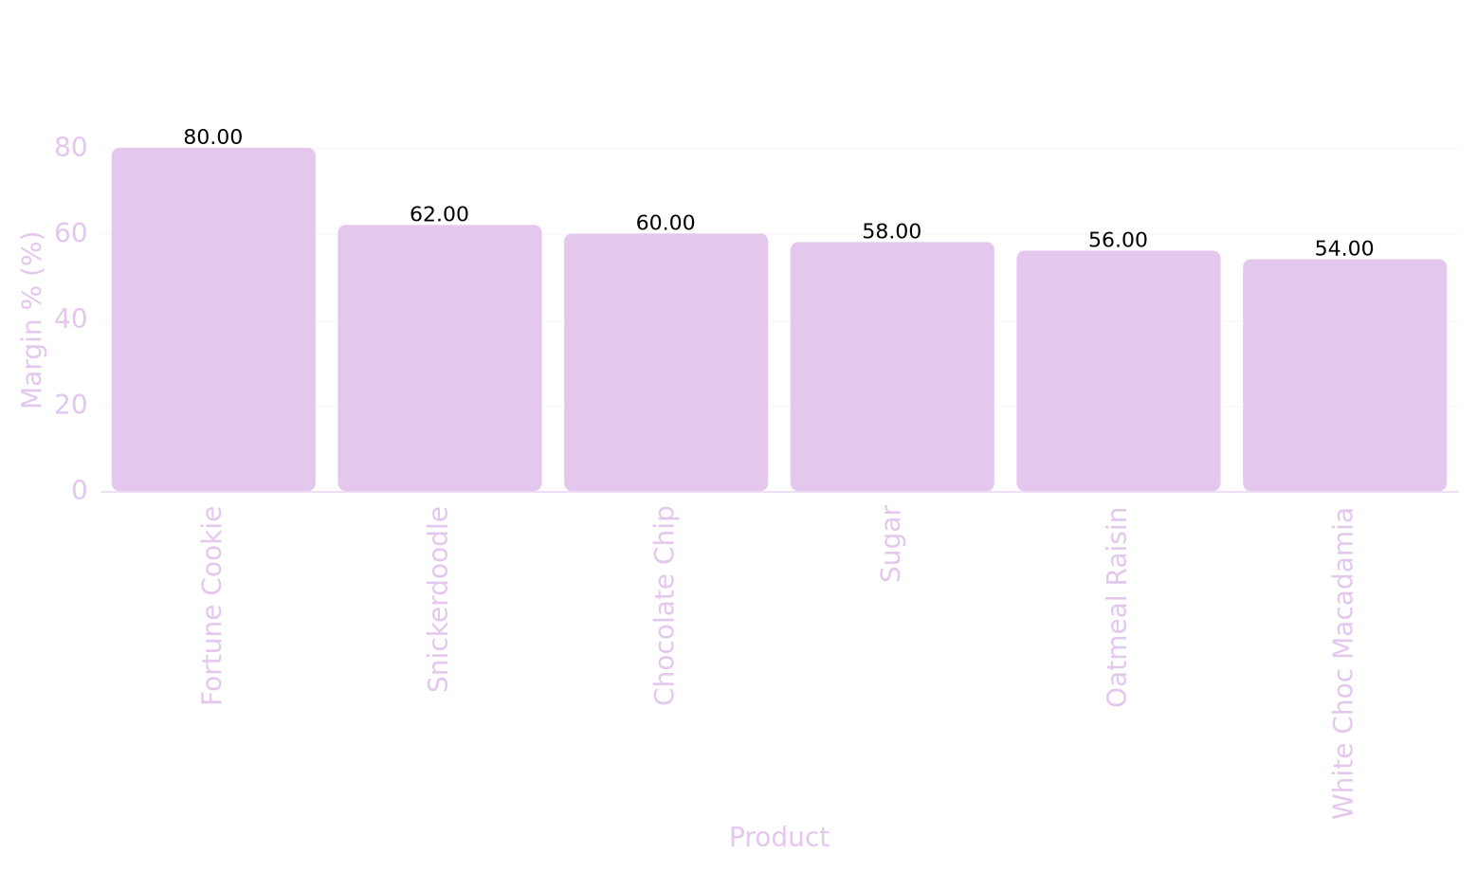
Margin Performance Overview
Key Metrics
Comprehensive analysis reveals significant margin variation across 6 products, ranging from 54% to 80%, with corresponding COGS intensity spanning 20%-46% of sale price. Two structurally challenged items (Oatmeal Raisin at 56% and White Chocolate Macadamia Nut at 54%) underperform industry cookie margins, while Fortune Cookie dominates with exceptional 80% margin despite lowest unit volume, demonstrating inverse correlation between margin and sales volume.
Margin Range
54%-80%
Significant variation across product portfolio with Fortune Cookie leading at 80%
Product Margin % Hierarchy vs Industry Context
COGS Intensity
20%-46%
Cost of goods sold as percentage of sale price shows inverse relationship with margin performance
Challenged Items
2 products
Oatmeal Raisin and White Chocolate Macadamia Nut fall below 57% margin threshold

Slide 6
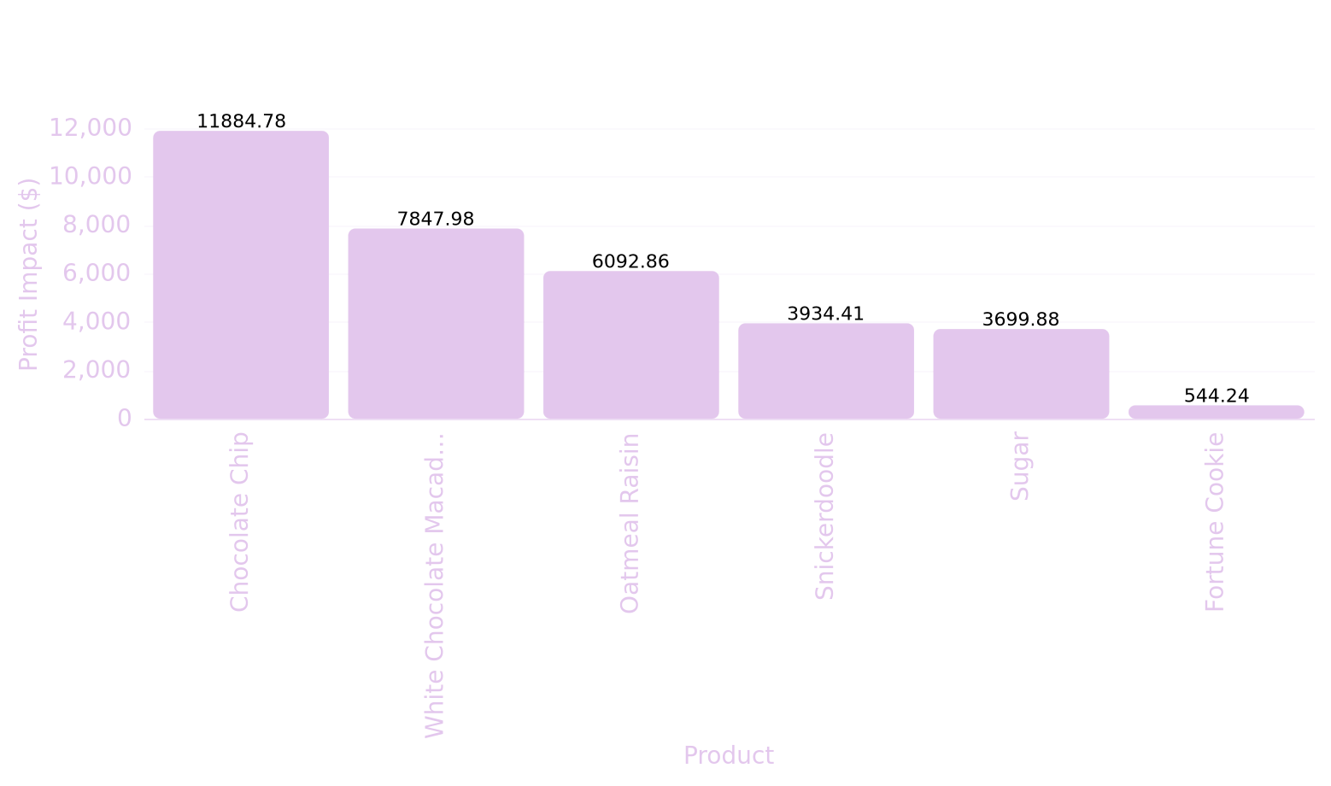
Cost Reduction Impact Analysis
Impact Metrics
Quantified 1% COGS reduction impact across products shows Chocolate Chip ($11,885 potential) and White Chocolate Macadamia Nut ($7,848 potential) offer highest absolute profit enhancement, driven by high COGS per unit (2.0-2.75) multiplied by large unit volumes (262k-594k units), representing primary cost optimization targets.
Top Priority
$11,884.78
Highest absolute profit enhancement potential from COGS optimization
1% COGS Reduction Impact by Product: Absolute Profit Improvement Potential
Secondary Priority
$13,940.84
Combined secondary product optimization opportunity
Optimization Range
0.25%-0.85%
Profit improvement rate range across product portfolio

Slide 7
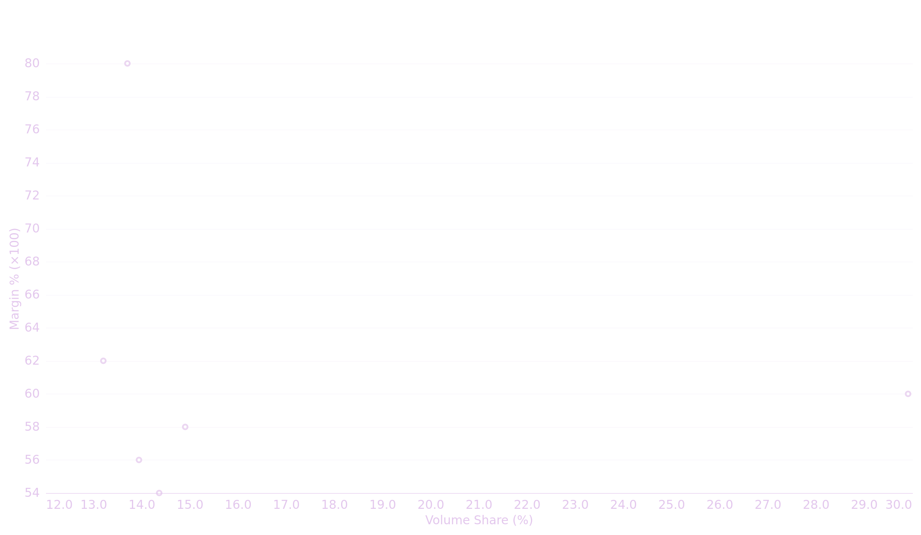
Key Findings
Product Volume-Margin Trade-Off & Profit Contribution Positioning
Chocolate Chip emerges as the primary profit driver with a 17.95 efficiency score, commanding 29.91% volume share and contributing 36.55% of total profit despite maintaining a 60% margin. In contrast, Fortune Cookie achieves the highest margin at 80% but delivers only 4.46% profit contribution due to significant volume constraints at 13.7%. This analysis reveals that profit efficiency is not solely determined by margin percentage but rather by the strategic balance between margin and volume positioning across the product portfolio.

